Slide 1
Business Report on Google App Store App Data
Presented by
Palak Grover
Data Analytics
GLDA BLR Dec’22 Batch

Slide 2
STAR FORMAT: Google App Store: App Data Project
Situation - App developers want to know the predict success of the collected data their apps on the Google app store
Task - To investigate "App Ratings" are provided by the customers through EDA on attributes like App Category, Reviews, Installs, and so on
4D Framework:
Part - 1 - Data
Part - 2 - Descriptive Analysis
Part - 3 - Data Modeling
Part 4 – Deploy the Model

Slide 3
We will focus mainly on the above three D- frameworks:
1 - Data
Data Comprises: We have the data from the of the dataset for app store such as different category apps, type of app, ratings, reviews, size of an app, installs made so far, and price of each app category
2 - Descriptive Analysis
Data cleaning
Analysis of Overall “User Ratings” on app in the app store
Data Standardization
Visualization of average rating for different category apps in the app store
Descriptive Analysis - "Summarizing via Visualization"

Slide 4
3 - Data Modeling
Building a model by splitting the data into Train (X as Reviews at first analysis, then all the columns in the second phase of analysis) as Test while keeping the Rating Category as the target variable
Results - Overall "User Ratings" to apps provided by the customers based on App Category, Price, and Reviews

Slide 5
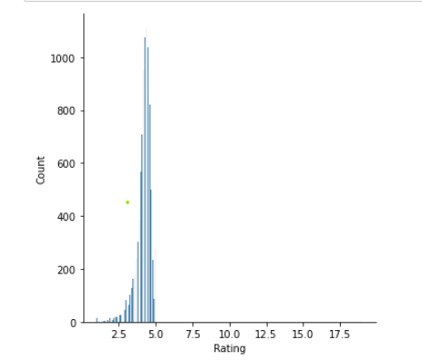
Ratings For All Category Apps
It was observed that the median of Ratings were observed as 4.3. The frequency for 4.4. rating was the highest. We inferred that mode is to the right of the mean (which was 4.19) and the hence, the “Displot” for ‘Rating’ was right skewed with a skewness of ‘0.596.

Slide 6
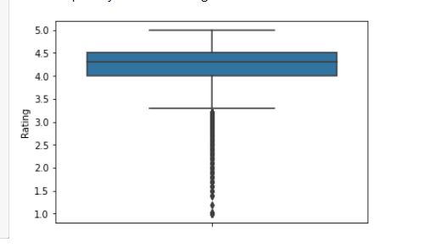
Rating Boxplot With No Outliers
After removing an outlier, a clear boxplot with no outlier presence was obtained, the true values or the ratings were between 1 and 5. The most of the ratings were between 4.0 and 4.5, where the median lies in the boxplot below. Also, some of the ratings were between 1.0 and 3.0

Slide 7
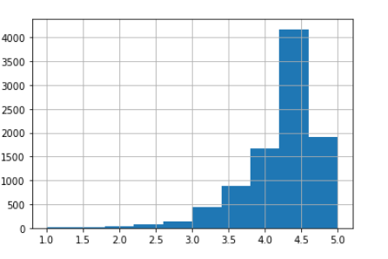
Rating Category: Histogram
The below histogram shows that the “Rating Category" is at peak between 4.0 and 4.5. However, to get more clear picture of which rating either lesser than 3.5 or greater than 3.5 is given for apps on Google App Store

Slide 8
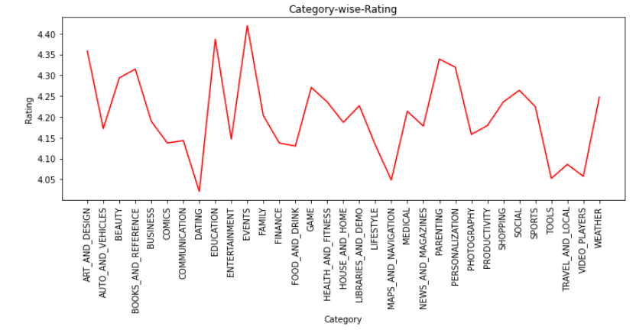
Category-Wise-Rating
The "Events" category apps got the rating between 4.40 to 5 (above we got was 4.419) - Sum of price of all apps under Events category - 109.99
The second highest is "Education" with rating between 4.35 to 4.40 (we got it as 4.38) - Sum of price of all apps under Education category- 17.96
The third highest is "Art_and_Design", and the rating is little higher than 4.35 (we got it as 4.358) - Sum of price of all apps under Art_and_Design category - 5.97

Slide 9
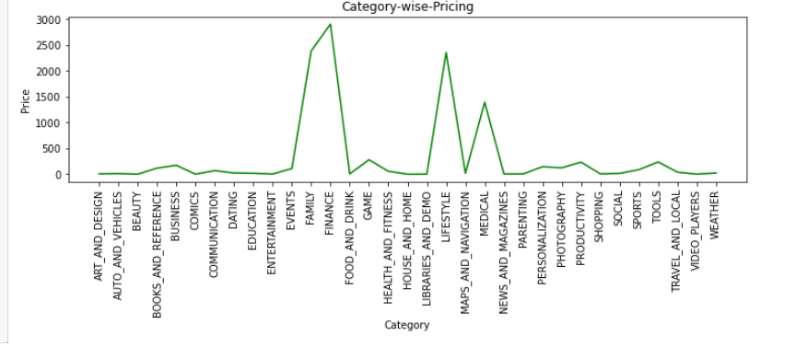
Category-Wise-Pricing
'Finance' category app: The sum of a price of all apps under this category was the highest, i.e., '2900.83'
'Family' category app: The sum of a price of all apps under this category was the second highest, i.e.,'2380.91'
'Lifestyle' category app: The sum of a price of all apps under this category was the third highest category, i.e., 2353.39

Slide 10
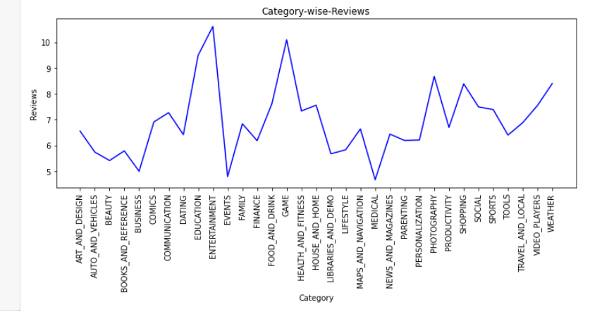
Category-Wise-Reviews
The Entertainment category app got the highest reviews, i.e., 10.6
The second highest was "Game" with average reviews of '10.09'
The third highest was "Education" with average reviews of '9.489’

Slide 11
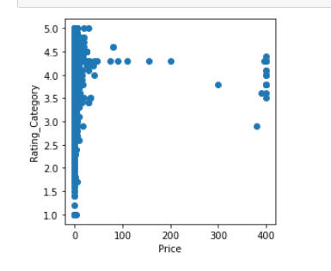
Is Rating _Category Getting Affected by Price?
Yes, the scatter on App price vs Rating_Category shows that the lesser is the price of an app, the higher is the rating, and vice-versa.

Slide 12
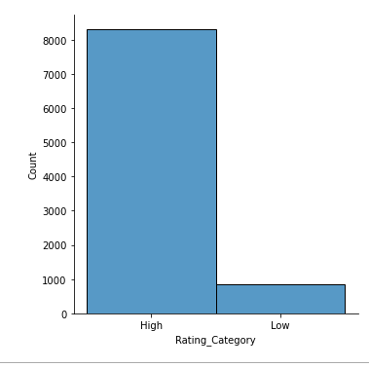
Count of Rating_Categories
We can infer that "High" rating category have got higher count than the ones with the "Low" category. Meaning, if developers reduce the price of the apps, this is possible that if they incorporate new features into apps, the user will continue to give rating higher than "3.5"

Slide 13
Insights on Graphs for Category App vs Average Rating, Sum of Prices, and Overall Reviews
Plot for Category Apps vs Average Rating
The graph for Category vs Average Rating shows that the category "Events" apps have got an average of '4.419298' Rating
Plot for Category App vs Pricing
The graph for Category vs Pricing shows that all the apps under "Events" category has a total price of '109.99’
Plot for Category Apps vs Reviews
The graph for Category Apps vs average 'Reviews', this category made was less, which was '4.786986' as compared to "Entertainment", which got the "Highest" reviews around '10.611527'

Slide 14
Conclusion: Understanding from EDA
A. Rating_Category with Top 3 Highly-Rated Apps
The apps from categories such as Events, the sum of price of apps under this category was 109.99, is highly rated with 4.41 an average rating and Average Reviews - 4.79
The second is Education, the sum of price of apps under this category was 17.96, had the second highest average rating of 4.386 and Average Reviews - 9.489
Art_and_Design, the sum of price of apps under this category was 5.97 only, this category app got got the third highest average rating of 4.358 and Average Reviews - 6.554

Slide 15
Continue…
B. Rating_Category with Top 3 Costly App Categories
Finance, the costliest app category with the sum of price of 2900.83 got an average rating of 4.137 and Average Reviews - 6.179
Family, the second costliest app category with the sum of the price of 2380.91 got an average rating of 4.203 and Average Reviews - 6.835
Lifestyle, the third costliest app category with the sum of the price of 2353.39 got an average rating of 4.132 and Average Reviews - 5.827

Slide 16
Continue…
C. Rating_Category with High Reviews App Categories
Entertainment, the app category with the highest average reviews of 10.6, got an average rating of 4.15 and the sum of price of apps under this category was 2.99 only
Game, the app category with the second highest average reviews of 10.09, got an average rating of 4.27 and the sum of price of apps under this category was 279.34
Education, the app category with the third highest average reviews of 10.09, got an average rating of 4.86 and the sum of price of apps under this category was 17.96 only

Slide 17
UNDERSTANDING FROM MODEL SCORES¶
The model is not performing better. But still, from RMSE value of 0.282, the less errors can be seen
The value for Adjusted R2 is just 22%
Here, we need more data to predict the overall success of the apps in the app store. Developers thinking of incorporating more features into apps can help predict the rating_category.
Hence, given Log Transformation does'nt seem to be adding much value, so raw data to be used for further analysis

Slide 18
SUGGESTIONS TO APP DEVELOPERS
Keeping the price range low for apps even after incorporating the new features into app will continue the rating category of apps above 3.5.
Education is second highly rated and third highly reviewed and this category app will boom the market, so suggestion is to keep updating the features of this category apps with low price range.

